Slide 1

Shovels and Swords
Mauricio Carazas Segovia

Slide 2
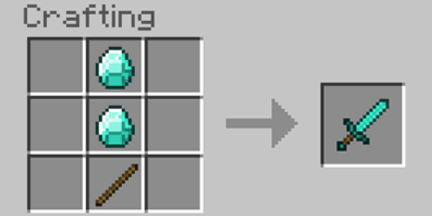
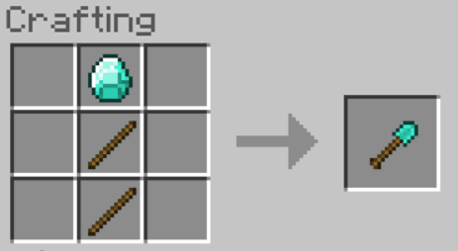
Polycarp plays a well-known computer game (we won't mention its name).
In this game, he can craft tools of two types — shovels and swords. To craft a shovel, Polycarp spends two sticks and one diamond; to craft a sword, Polycarp spends two diamonds and one stick.
Each tool can be sold for exactly one emerald. How many emeralds can Polycarp earn, if he has a sticks and b diamonds?

Slide 3


Slide 4
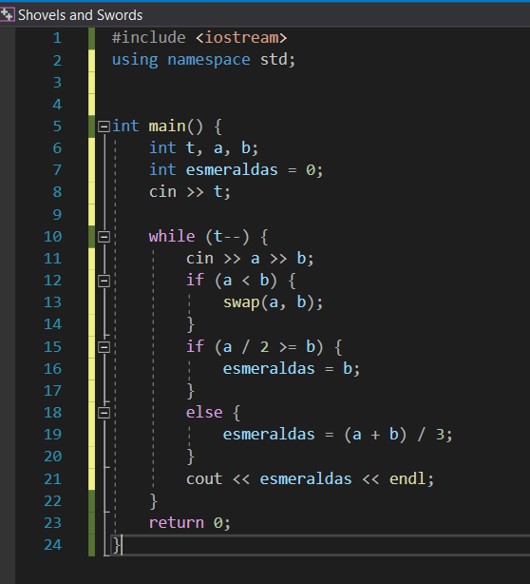

Slide 5
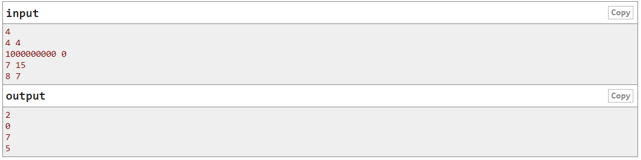

Slide 6
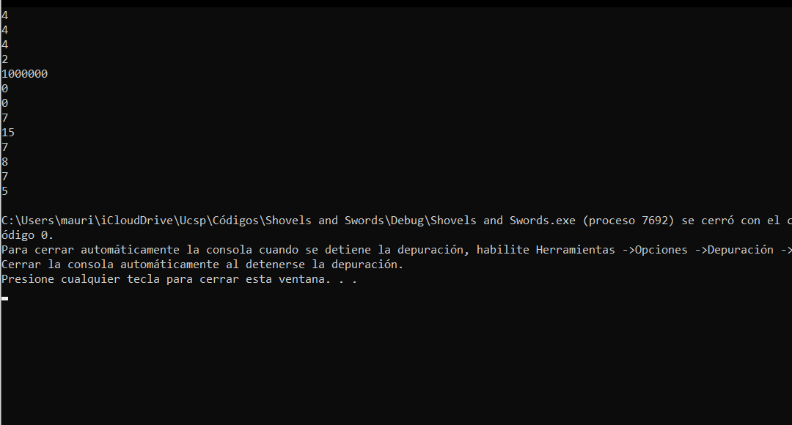

Slide 7
